Slide 1
COMP 494 Final Project Presentation
Team: Daniel Matlock
Date: 4/28/2022

Slide 2
Table Of Contents
Data Description and Problem Definition
Data Importing and Processing
Data Analysis and Visualization
Data Analytics

Slide 3
Data Description and Problem Definition

Slide 4
Data Description and Problem Definition
Describes (almost) every aspect of residential homes in Ames, Iowa
79 explanatory variables
Goal: predict the final price of each home
Location: https://www.kaggle.com/competitions/house-prices-advanced-regression-techniques/data

Slide 5
Data Importing and Processing

Slide 6
Data Importing and Processing
Target Variable: Sale Price
1460 Total Records
43 Categorical Variables
37 Continuous Variables (including Sale Price)
Variables: Lot area, house style, year built, overall quality, 1st & 2nd floor square footage, # of bedrooms, # of bathrooms, kitchen quality, neighborhood name, zip code, etc.

Slide 7
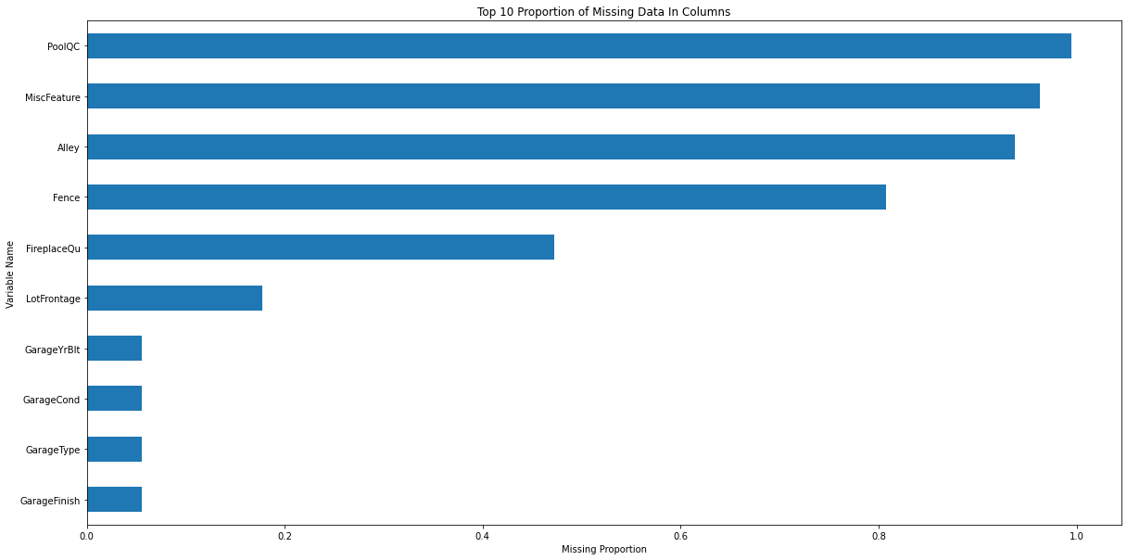
Data Importing and Processing

Slide 8
Data Importing and Processing
Imputed PoolQC missing data as “None”
Imputed other columns missing data as “None” (Alley, Fence, Garage Type, etc.)
Imputed some contentious variables with the Median (Lot footage by neighborhood)
Imputed Sale Type and Kitchen variables quality with the mode
Dropped the Utilities column
After doing all this there were no missing values

Slide 9
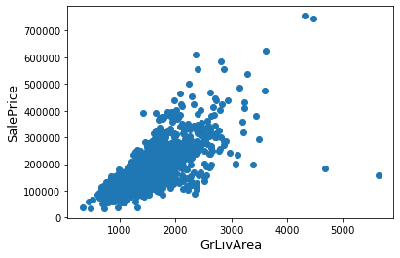
Data Importing and Processing
Handling outliers
Removed outliers where Living Area > 4000 and Sale Price is less than 300,000

Slide 10
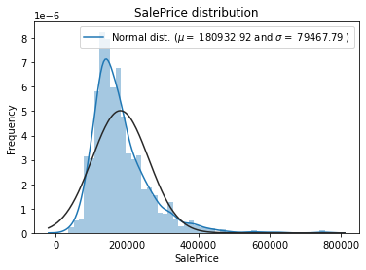
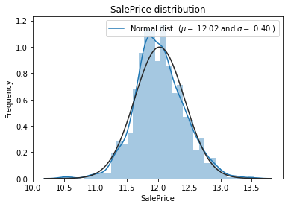
Data Importing and Processing
Normalized target variable (Sale Price) to reduce skew

Slide 11
Data Analysis and Visualization

Slide 12
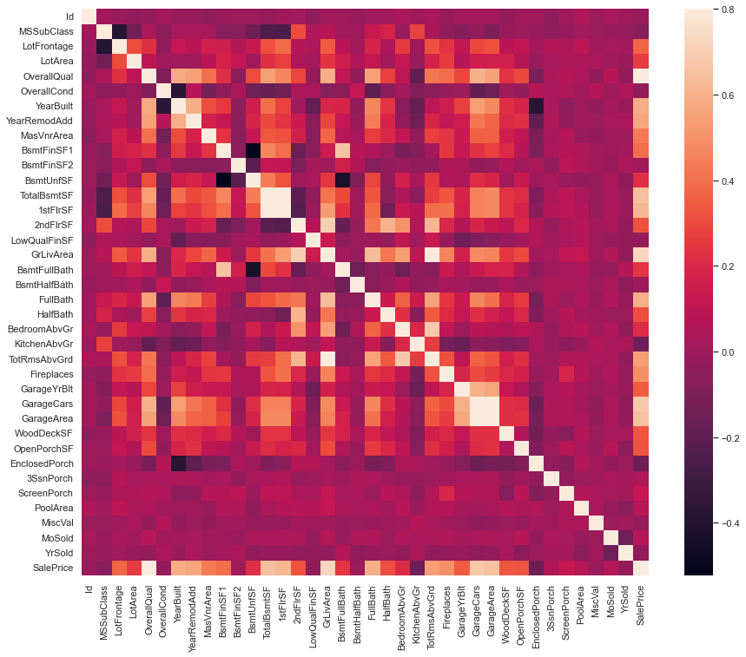
Data Analysis and Visualization
Looked at correlation matrix to determine if there were andy highly correlated variables with our target variable
We see there are quite a few

Slide 13
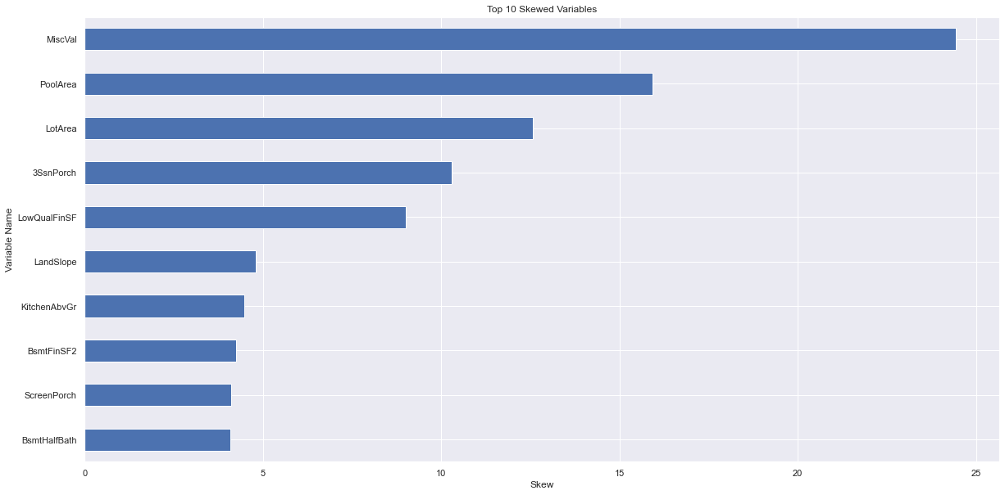
Data Analysis and Visualization
Remove Skew Features
Removed 61 features with a skew greater than 0.75
Feature Engineering
Created “Total Square Footage” Feature
Total Square Footage = Basement Square Footage + 1st Floor Square Footage + 2nd Floor Square Footage

Slide 14
Data Analytics

Slide 15
Data Analytics
Used a 5 fold cross validation (80% train, 20% test split)
Trained 5 different algorithms
Linear Regression (No Intercept)
K-Nearest Neighbors Regressor
Decision Tree
Random Forest
Gradient Boosted Machines
XGBoost
LightGBM
Root Mean Square Error was used as evaluation metric
This was selected as the root attempts to minimize the impact of incorrect predictions on outliers

Slide 16
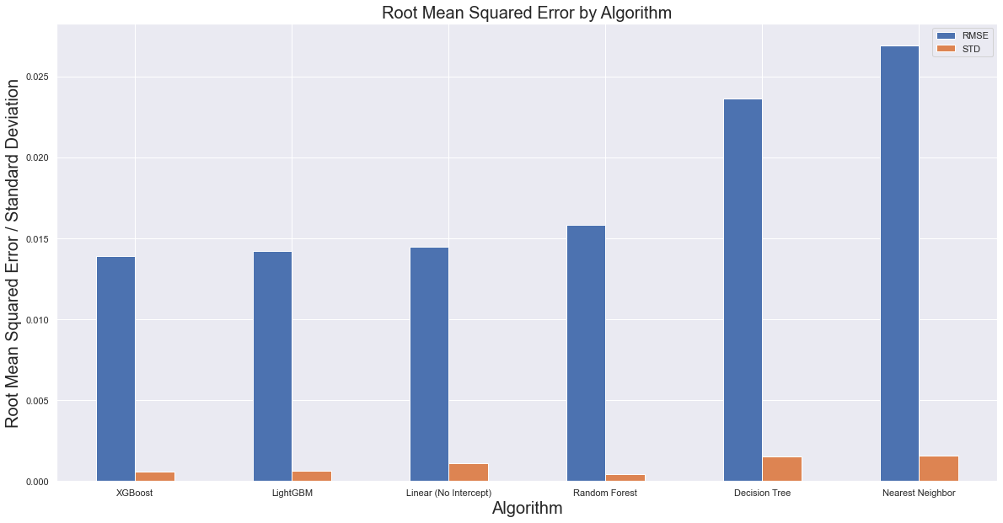
Data Analytics

Slide 17
Data Analytics
We see that the Gradient Boosted Machine models perform the best
We notice that although the Linear Model with no intercept performed slightly better than the Random Forest, it had a higher standard deviation between folds

Slide 18
Questions?

Slide 19
Appendix

Slide 20
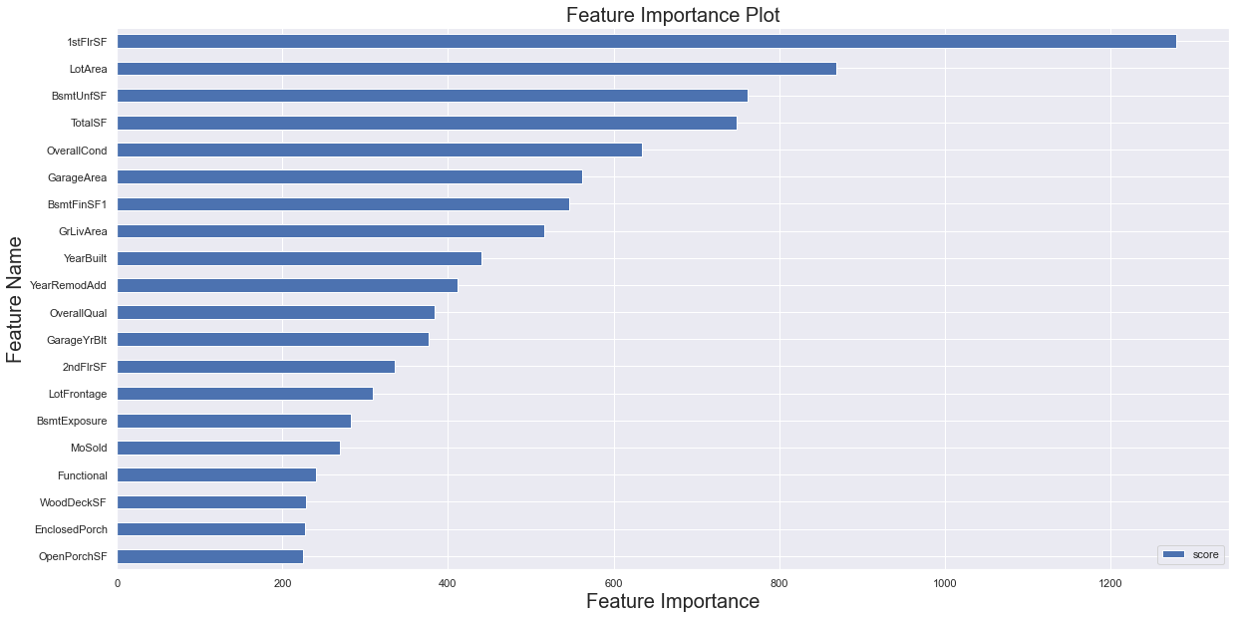
Data Analytics

